Slide 1

Analyze Twitch Gaming Data
Analyze Data with SQL
Mohammad Reza Sadeghi

Slide 2
Table of Contents
What are the unique game and channels in stream?
What are the most popular games?
Where are most LoL stream viewers located?
What sources users use to watch players stream?
Specify group of the games into their genres?
What is view count for each hour?
Conclutions

Slide 3
1. Unique game and channels

Slide 4
1. What are the unique game and channels in stream table?
We have two table on the right that shows what are the distinct games are on twitch stream and the other show the unique channels that are streaming.
Games
League of Legends
DayZ
Dota 2
Heroes of the Storm
Counter-Strike: Global Offensive
Hearthstone: Heroes of Warcraft
The Binding of Isaac: Rebirth
Agar.io
Gaming Talk Shows
Rocket League
World of Tanks
Channels
channel
jerry
elaine
frank
estelle
george
newman
susan
kramer
morty
helen
SELECT DISTINCT game FROM stream
SELECT DISTINCT channel FROM chat

Slide 5
2. Most popular games

Slide 6
2. What are the most popular games on stream table?
Games | Players
League of Legends | 1070
Dota 2 | 472
Counter-Strike: Global Offensive | 302
DayZ | 239
Heroes of the Storm | 210
The Binding of Isaac: Rebirth | 171
Gaming Talk Shows | 170
Hearthstone: Heroes of Warcraft | 90
World of Tanks | 86
Agar.io | 71
Rocket League | 49
SpeedRunners | 20
ARK: Survival Evolved | 19
Duck Game | 5
Fallout 3 | 3
Batman: Arkham Knight | 3
Breaking Point | 2
Block N Load | 2
Devil May Cry 4: Special Edition | 1
In the left table you can see how many players each game have on twitch stream.
The most player game is League of legends known as LOL with 2 times more player on twitch than second rank.
SELECT game, COUNT(player) as 'Players'
FROM stream
GROUP BY 1
ORDER BY 2 DESC

Slide 7
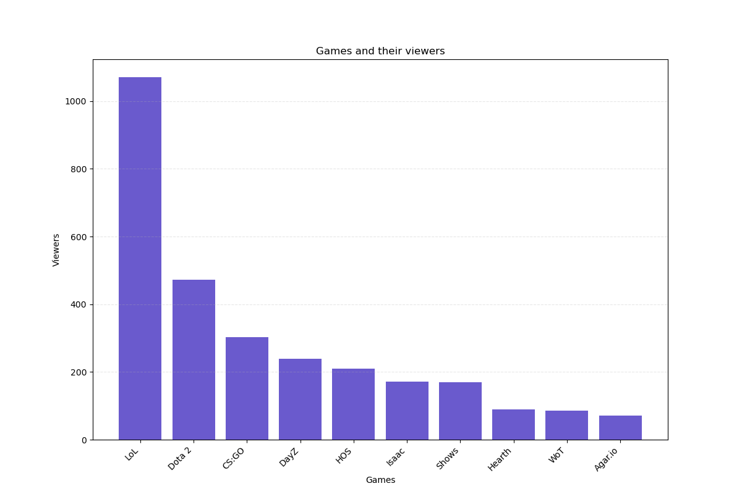
The chart is
right-skewed so it means first four games get the most view than the rest

Slide 8
3. Locatoin of LoL stream viewers

Slide 9
3. Where are most LoL stream viewers located?
Country | LOL Players
US | 447
DE | 66
CA | 64
NULL | 49
GB | 45
TR | 28
BR | 25
DK | 20
PL | 19
NL | 17
BE | 17
SE | 16
RO | 16
MX | 16
PT | 15
FR | 15
AU | 15
NO | 13
IT | 13
GR | 10
ES | 10
You can see the location of LOL players in the table on the right.
I exclude countries that have less than 10 players on LOL game but you can see full result if you run the below prompt.
Most players of LOL are from U.S and they are about 7 time more than second rank .
SELECT country, COUNT(*) AS 'LOL Players'
FROM stream
WHERE (game = 'League of Legends')
GROUP BY 1
ORDER BY 2 DESC

Slide 10
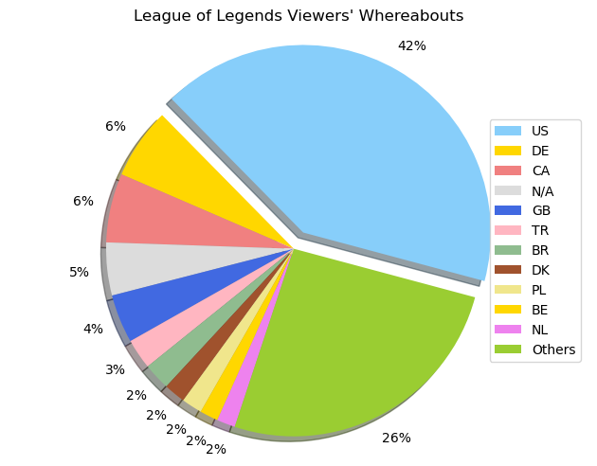
You can see better view of LOL whereabouts in chart

Slide 11
4. Sources users use to watch

Slide 12
4. What sources users use to watch players stream?
Users use different platform to watch twitch streamers that shown in left table.
Most of users use site it self and smartphones to watch streams.
Site users have about 45 % of popularity and its most use to watch streams, iphone and android phones are 2nd and 3rd place to watch but over all of these two is about 38 % and still so lower than users who use the site to watch streams.
Player | Users | Percentage
site | 1365 | 45.5
iphone_t | 622 | 20.73
android | 547 | 18.23
ipad_t | 290 | 9.66
embed | 125 | 4.16
xbox_one | 22 | 0.73
home | 16 | 0.53
amazon | 6 | 0.2
frontpage | 4 | 0.13
xbox360 | 1 | 0.03
roku | 1 | 0.03
chromecast | 1 | 0.03
SELECT player , COUNT(*)
FROM stream
GROUP BY 1
ORDER BY 2 DESC

Slide 13
5. Games and their genres

Slide 14
5. Specify group of the games into their genres?
You can see the genres of games beside them.
Multiplayer Online Battle Arena (MOBA), First Person Shooter (FPS), Survival.
Campaign | Genre | Users
League of Legends | MOBA | 1070
Dota 2 | MOBA | 472
Counter-Strike: Global Offensive | FPS | 302
DayZ | survival | 239
Heroes of the Storm | MOBA | 210
The Binding of Isaac: Rebirth | Other | 171
Gaming Talk Shows | Other | 170
Hearthstone: Heroes of Warcraft | Other | 90
World of Tanks | Other | 86
Agar.io | Other | 71
Rocket League | Other | 49
SpeedRunners | Other | 20
ARK: Survival Evolved | survival | 19
NULL | Other | 15
Other games | Other | 16
WITH genre AS (
SELECT game,
CASE
WHEN (game = 'League of Legends') OR
(game = 'Dota 2') OR
(game = 'Heroes of the Storm')
THEN 'MOBA'
WHEN game = 'Counter-Strike: Global Offensive' THEN 'FPS'
WHEN (game = 'DayZ') OR
(game = 'ARK: Survival Evolved')
THEN 'survival'
ELSE 'Other'
END AS 'genre',
COUNT(*)
FROM stream
GROUP BY 1
ORDER BY 3 DESC) SELECT * FROM genre

Slide 15
6. Viewers in each hour

Slide 16
6. How many users view streams in each hours of day in U.S?
Because of time differences I Choose US as most country that players and viewers therefore you can see which hour of the day users watch streams the most in tables.
Users mostly watch streams from 18 – 22 and from 5 – 10 twitch have least viewers.
Except (20 - 21) and (5 – 10) we don’t have a lot of difference between viewers so most of the day people get online to see streams.
Time | View count
21 | 120
20 | 102
19 | 81
18 | 76
22 | 71
16 | 69
23 | 63
12 | 62
13 | 58
17 | 55
15 | 51
11 | 48
Time | View count
14 | 40
02 | 34
00 | 30
03 | 29
04 | 19
01 | 17
05 | 14
09 | 9
10 | 5
08 | 4
06 | 3
07 | 2
SELECT
strftime('%H', time) AS 'Time',
COUNT(*) AS 'View count '
FROM stream
WHERE country = 'US'
GROUP BY 1
ORDER BY 2 DESC

Slide 17
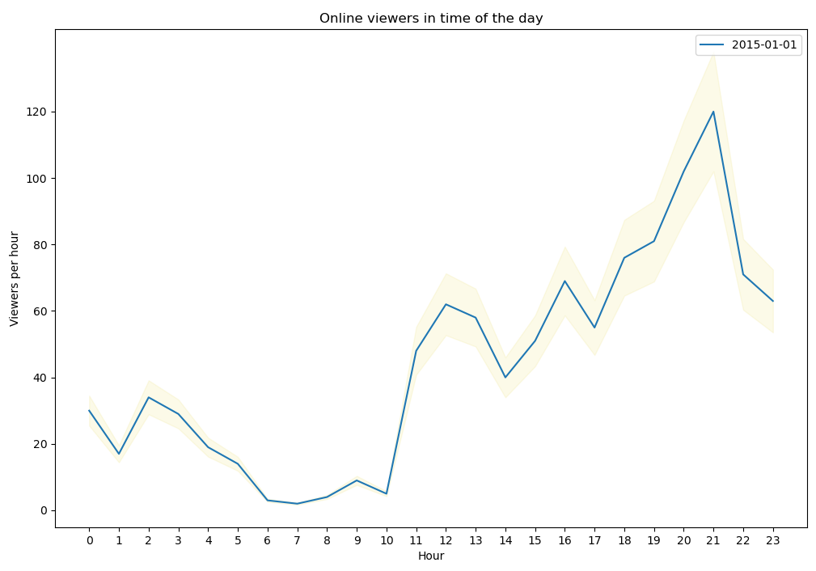
There is some uncertainty in these numbers because some people leave their browsers open. Let’s account for a 15% error in the viewers_hour data.
From 10 Am viewers count grows and in 21 get to the highest and then start to drop again

Slide 18
7. Conclutions

Slide 19
7. Conclusions
League of legends known as (LOL) is the most play that players choose for stream on twitch.
US have most players among all of the countries. It has 1062 players from 3000 players and second rank is Taiwan with 178 users.
Most of users use site it self to watch streams so it’s the most wanted source and after that they use mobile phones to watch streams.
Multiplayer Online Battle Arena (MOBA) is really popular among player and viewers, it contain more than 50 % of traffics.
Users mostly watch streams from 18 – 22 and from 5 – 10 twitch have least viewers but they don’t have a lot of difference between viewers so most of the day people get online to see streams.

